Slide 1


Slide 2
AGENDA
What is NodeJS?
How does Node Work?
Why NodeJS?
Architecture Diagram
NodeJS vs Other Similar frameworks
What is v8 ?
Installing Node.js and NPM
Blocking(Synchronous) vs Non-Blocking(Async)
Event Loop
NPM and commands

Slide 3
AGENDA Conti...
Node-modules
Package.json
REPL (Read-Eval-Print-Loop)
Node Fundamentals
Modules
Callbacks
Events
Streams
Buffers
File System
Error handling

Slide 4
AGENDA Conti...
Creating a server with the HTTP module
Building Command Line Apps
Assignments

Slide 5
What is Node JS?
Open-source platform =Application + Server
Built on Chrome's JavaScript engine V8 to execute code
Event-driven and non-blocking I/O.
Coding in Javascript.
Single Threaded .
DIRTY(Data Intensive RealTime ) Applications
Used by IBM,Microsoft,Yahoo!,Walmart,Groupon, SAP,LinkedIn, PayPal,and GoDaddy

Slide 6
How does Node JS works ?

Slide 7

Use-Case Problem
Restaurants Problem

Slide 8

Use-Case Solution 1
Serve on the Basis of order completion till that time wait in restuarent .

Slide 9

Use-Case Solution 2
Opening Many Restaurents

Slide 10
Why Node JS ?
Same coding standard at client and server side i.e jS .
Code Reuse .
It's Fast .
Real-time .
Streaming data .

Slide 11
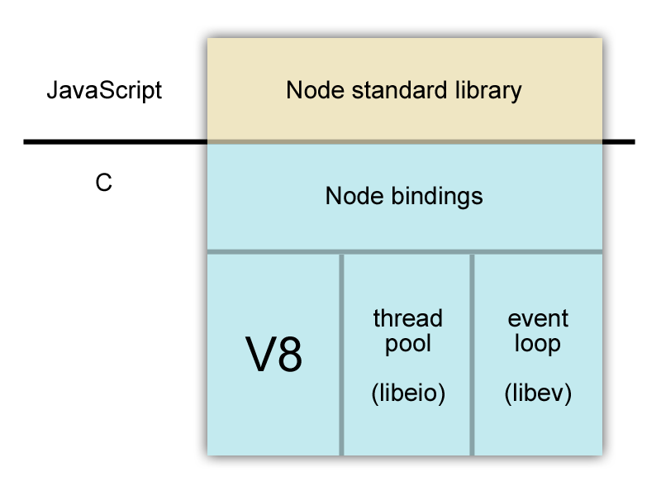
Architecture Diagram

Slide 12
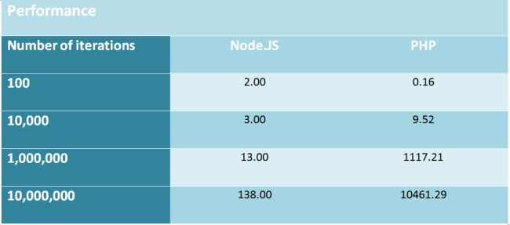
NodeJS vs others servers
Performance

Slide 13
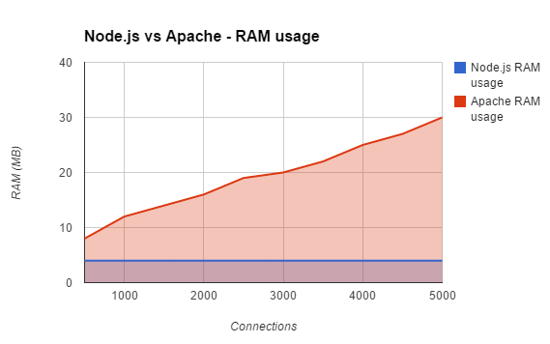
NodeJS vs others servers
Memory Usage

Slide 14
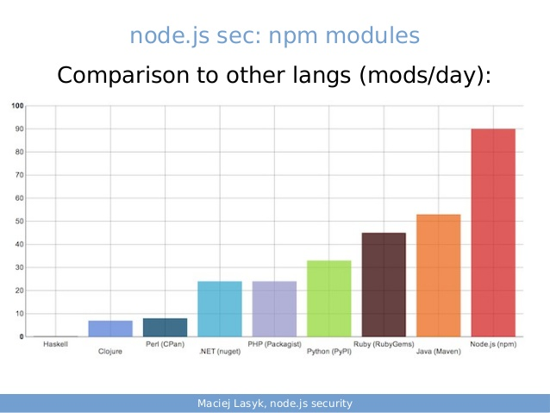
NodeJS vs others servers
No of modules (library)

Slide 15
What is v8 ?
Google's open source high-performance JavaScript engine .
Written in C++ .
Used in Google Chrome .
Implements ECMAScript .
Executes javascript code .
https://developers.google.com/v8/?hl=en

Slide 16
Installing Node & npm

Slide 17

Blocking vs Non-Blocking IO
Blocking Use Case
Blocking IO is something like "you waiting for your someone to join you on a date, you wait for her indefinitely"

Slide 18



Blocking vs Non-Blocking IO
Non-Blocking Use Case
Non-blocking IO is like "you have asked someone to join you on a date, but you are not sure if she turns up so early, so you decide to do other works pending, or sometimes you get bored and may try asking another girl for a date".

Slide 19
Blocking vs Non-Blocking IO
var fs = require('fs');
var contents = fs.readFile('./users','utf8', function(err,contents){
console.log(contents);
});
console.log("Hello Node\n");
var fs = require('fs');
var contents = fs.readFileSync('users','utf8');
console.log(contents);
console.log("Hello Node\n");

Slide 20
Event Loop
Event loop is single-threaded .
Event loops is core of javascript , all events , requests are handled by event loop.
Works on event driver framework.
Handle highly concurrent requests .
Blocking the event loop can have catastrophic effects on the Node application.

Slide 21
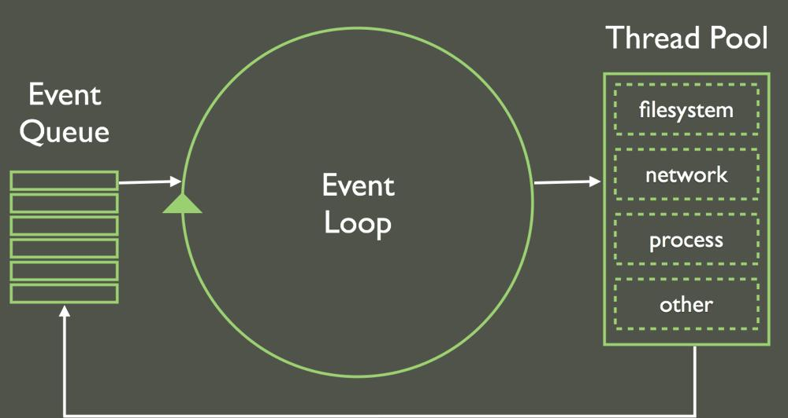
Event Loop

Slide 22
Event Loop
http://latentflip.com/loupe/

Slide 23
NPM commands
NPM is an online registry for open-source node.js projects, modules, resources, etc
Provides a command line interface (CLI) for interacting with the registry.
NodeJS package manager : install , update all node module (3rd party libraries)
Getting help: npm help
Installing stuff: npm install [-g] [package-name]
Showing all node modules : npm ls
Updating packages : npm update [-g] [package-name]
Making a package.json file.
Use npm init [ --force ] to generate package.json

Slide 24
Node modules
The core modules are defined within Node.js's source and are located in the lib/ folder.
Core modules are always preferentially loaded
Few core node-modules:
Cluster
Console
Crypto
DNS
Errors
Events
File System
Globals
HTTP

Slide 25
Package.json
All npm packages contain a file, usually in the project root, called package.json
Holds various metadata relevant to the project
{
"name" : "underscore",
"description" : "JavaScript's functional programming helper library.",
"author" : "Jeremy Ashkenas <jeremy@documentcloud.org>",
"dependencies" : [],
“devDependencies” : [],
"repository" : {"type": "git", "url": "git://github.com/documentcloud/underscore.git"},
"main" : "underscore.js",
"version" : "1.1.6"
}

Slide 26
REPL
Read-Eval-Print-Loop (REPL) is available both as a standalone program and easily includable in other programs
The REPL provides a way to interactively run JavaScript and see the results .
Type “node” in your terminal. Try following code now
1+2
console.log(“hello world”);
var name='vishnu';
console.log(name);

Slide 27
Node Fundamentals -Modules
Modules
Building block of a node application
Seprate our components based on business logic.
Modules can be single files or directories containing one or more file.
Three types of modules
1 . Core node modules (installed using npm cmd)
2. Thirdy party node modules(available in node core libraries i.e default module)
3. Custom modules. ( we make these modules).

Slide 28
Node Fundamentals-Modules
How to make a custom modules .
Use these steps
Create a file named “demo-module.js”
Write these lines into this file :
exports.myFun = function() {
console.log(“demo-module data”);
}
Create a new file name “main.js” :
Write these lines in it :
var demoModule=require(“./demo-module”);
demoModule.myFun();

Slide 29
Node Fundamentals-Modules
Exports vs module.exports
Exports : if you want to expose more than one function or variable, then we can set property of object called “exports”.
Module.exports : if you want to return single function/variable/object.
KEY POINT TO NOTE :
node perform syncronous lookup in order to locate file contents of module.
When you use require(“filename.js”) , extention “.js”is optional .
If you create module that populates both “exports” and “module.exports”
,then “module.exports” will be returned and exports will be ignored

Slide 30
Node Fundamentals-Modules
Exports is only set on object/functions not on class .
For eg :
var Currency=function(dollar){
this.dollar=dollar;
}
Currency.prototoype.roundTwoDecimals=function(amount){
return Math.round(amount*100)/100;
}
exports=Currency //This line will give you error instead of this use “module.exports”

Slide 31
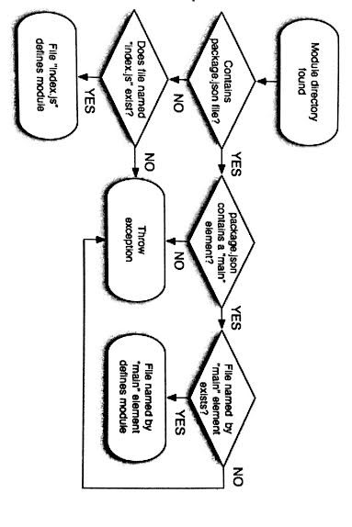
Node Fundamentals-Modules
Steps to find a module :

Slide 32
Node Fundamentals-Callbacks
Callbacks : a function which is passed as an argument to a async function.
It is main concept behind asyncronous programming.
For example :
function myFun(name, cb){
console.log("myfun");
cb();
}
myFun("vishnu",function(){
console.log('Callback called');
})

Slide 33
Node Fundamentals-Callbacks
In Node file handling :
var fs=require('fs');
fs.readFile('filename',myFun);
function myFun(err, content){
if(err)
console.log(err);
console.log(content);
}

Slide 34
Node Fundamentals-Events
Events : change in state of an object.
At Node Side : Event Module
// Import events module
var events = require('events');
// Create an eventEmitter object
var eventEmitter = new events.EventEmitter();
// Bind the connection event with the listner1 function
eventEmitter.addListener('connection', listner1);
// Bind the connection event with the listner2 function
eventEmitter.on('connection', listner2);
// Fire the connection event
eventEmitter.emit('connection');

Slide 35
Node Fundamentals-Events
Event module Methods :
addListener(event, listener)
on(event, listener)
once(event, listener)
removeListener(event, listener)
removeAllListeners([event])
emit(event, [arg1], [arg2], [...])

Slide 36
Node Fundamentals-Streams
Streams are objects that let you read data from a source or write data to a destination in continous fashion.
In Node.js, there are four types of streams.
Readable - Stream which is used for read operation.
Writable - Stream which is used for write operation.
Duplex - Stream which can be used for both read and write operation.
Transform - A type of duplex stream where the output is computed based on input.

Slide 37
Node Fundamentals-Streams
Readable stream :
var fs=require('fs');
// Create a readable stream
var readerStream = fs.createReadStream('input.txt');
// Set the encoding to be utf8.
readerStream.setEncoding('UTF8');
// Handle stream events --> data, end
var data=””;
readerStream.on('data', function(chunk) {
data += chunk;
});
readerStream.on('end',function(){
console.log(data);
});

Slide 38
Node Fundamentals-Streams
Writable stream :
var fs = require("fs");
var data = 'Simply Easy Learning';
// Create a writable stream
var writerStream = fs.createWriteStream('output.txt');
// Write the data to stream with encoding to be utf8
writerStream.write(data,'UTF8');
// Mark the end of file
writerStream.end();

Slide 39
Node Fundamentals-Buffer
Buffer : similar to an array of integers but corresponds to a raw memory allocation outside the V8 heap.
Buffer class is a global class and can be accessed in application without
importing buffer module.
Creating Buffers :
var buf = new Buffer(100);
//writing into a buffer
len = buf.write("Simply Easy Learning");
console.log("Octets written : "+ len);
//reading from a buffer
buf.toString([encoding][, start][, end])

Slide 40
Node Fundamentals-File handling
Node File System (fs) module can be imported using following syntax:
var fs = require("fs")
Few methods of fs
fs.open(path, flags[, mode], callback) .
fs.stat(path, callback)
stats.isFile() Returns true if file type of a simple file.
stats.isDirectory() Returns true if file type of a directory.
stats.isBlockDevice() Returns true if file type of a block device.
stats.isCharacterDevice() Returns true if file type of a character device.
stats.isSymbolicLink() Returns true if file type of a symbolic link.
stats.isFIFO() Returns true if file type of a FIFO.
stats.isSocket() Returns true if file type of asocket.
fs.writeFile(filename, data[, options], callback).
fs.read(fd, buffer, offset, length, position, callback)
fs.close(fd, callback)

Slide 41
Node Fundamentals-Error handling
Error handling is a pain .
Easy to get by for a long time in Node.js without dealing with many errors correctly .
Building robust Node.js apps requires dealing properly with errors
Use try catch block: to handle errors.
Throw error : to throw customise error
process.on('uncaughtException')-To handle unhandled exception which stops your node server.

Slide 42
Node Fundamentals-HTTP SERVER
http://www.sitepoint.com/creating-a-http-server-in-node-js/

Slide 43
Thank you

